Slide 1

Course Report
Performance
Saumyaranjan Panigrahi
saumya.panigrahi19@gmail.com
+44-7867061376

Slide 2
Process Involved:
Understanding the dataset
Identifying the key problems
Loading, Data Preprocessing and Transforming data using Power Query Tool
Creating Visualizations
Analyzing the Data

Slide 3
Understanding the Dataset
Opened the dataset in Excel to get a sense of the contents.
Identified the columns, types of data, and any immediate issues such as missing values, inconsistencies, or duplicate records.

Slide 4

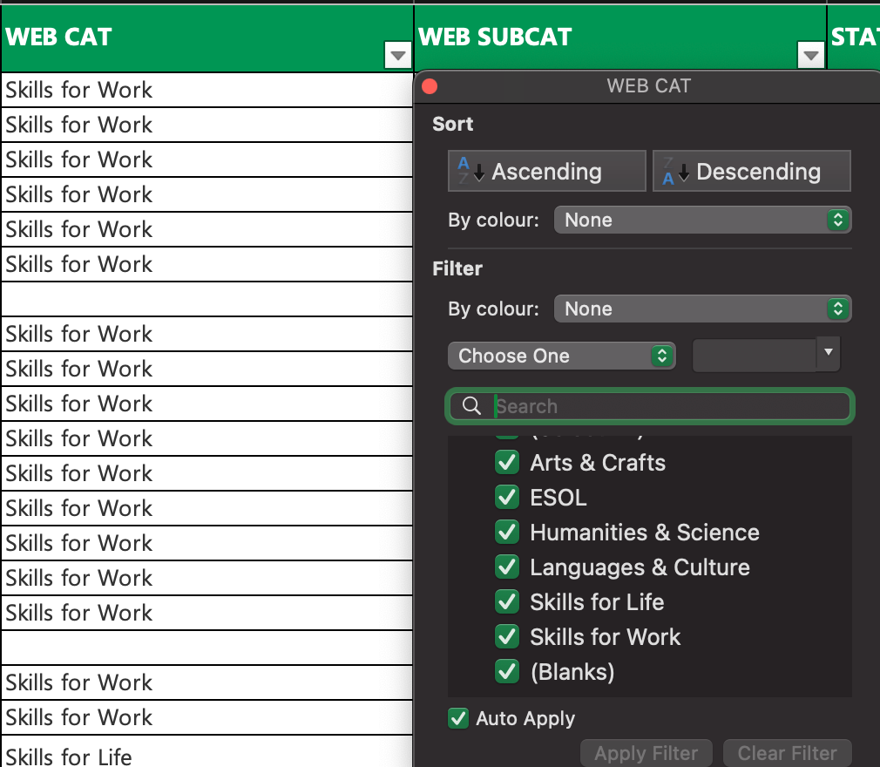
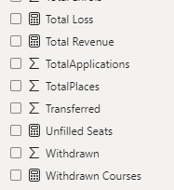

Data Pre-processing & Transforming
Removed unwanted columns (i.e. IAGType, OWN ORG, OFF ORG, Term, Fund Model, etc.)
Rename the inconsistent columns
Removed null values
Checked column data types
Added new calculated columns
Added new measures

Slide 5
Identifying the key problems
Visual Page: 1
How does the course report perform for each individual region?
What are the total places available and enrolments?
What is the enrolment trend across different regions for each course or category?
Is the course fee creating a huge gap in total places and enrolments?
Is the duration of course changing the mindset of students to enrol?
Are courses reaching their full capacity (i.e., are all places being utilized) / courses with high available places but few enrolments?
How long (duration) are the courses?

Slide 6
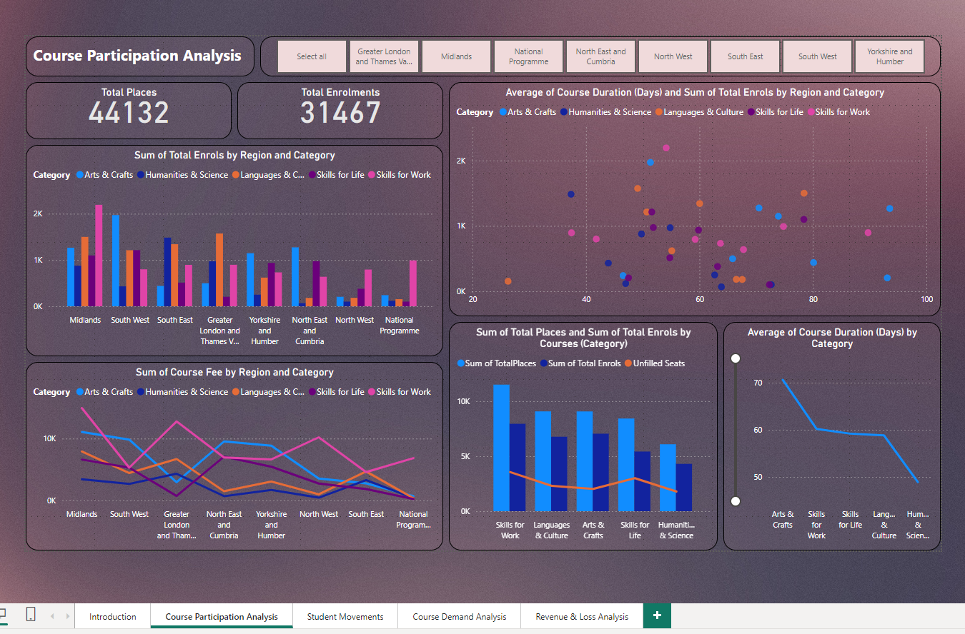
Visual 1: Course Participation
Slicer: Regions
Card: Total places available vs. total enrolments.
Clustered Column Chart: Total people enrolled for different sections by regions.
Line Chart: Course fee by Regions and Category
Scatter Plot: Average course duration in days and sum of total enrolment by regions and category.
Line & Clustered Column Chart: Sum of total places vs. total enrolment by sections.
Line Chart: Average of course duration by category

Slide 7
Problems & Solutions:
Course Duration: Decrease the course duration for courses in categories like skill for work, art & craft, so there is a chance of an increase in enrolment.
Less Advertisement: Running campaigns or advertisements for courses in skills for work, skills for life, etc. about the impact of this course in life so that we can minimize the gap between the total places available and the enrolments.
Course Fee: If we can reduce the course fee for courses in skill for work, art & crafts, etc. in some regions like the North West, Greater London, and Thames Valley, then there is a possibility of an increase in enrolments.

Slide 8
Identifying the key problems
Visual Page: 2
How many students has started and not started course by category?
How many in total has withdrawn and transferred from the course?
Track courses with high withdrawal and transferred rate.
What is the low completion rates (finished / Total Enrolment)?
What is the sum of students who started, finished and not finished the course by category?
How many sessions has been taken place for each category or course?
How many students have already finished the course in different regions?

Slide 9
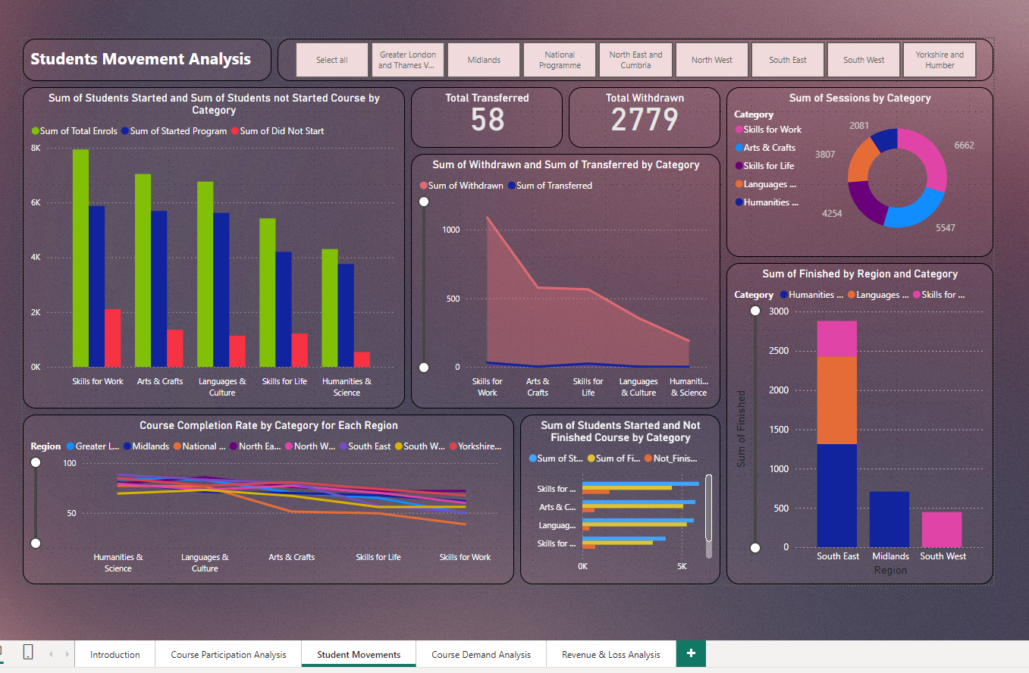
Visual 2: Student Movemenys
Clustered Column Chart: Sum of students started and sum of students not started course by category.
Card: Total transferred and total withdrawn.
Area Chart: Sum of withdrawn and sum of transferred by category.
Line Chart: Course completion rate by category for each region.
Clustered Column Chart: Sum of students started but not finished the course.
Donut Chart: Sum of sessions by category.
Stacked Column Chart: Sum of finished by region and category.

Slide 10
Problems & Solutions:
Less interest due to many sessions: Decrease the course sessions for each category so that people can keep themselves available for classes.
Less knowledge about course: Skills for work and skills for life have more transfer numbers. Creating awareness about the course and giving proper information about the particular subject can decrease the number.
High Course Fee: Failed to pay course fee / Could not give proper time because of the high course duration. Then less course fee can decrease the withdrawn rate.

Slide 11
Identifying the key problems
Visual Page: 3
Which courses require the most learning time? Does this impact enrolment or course completion?
How many sub-categories are avalable for each category type in all regions?
How many courses are "Active," "Closed," or in other states?
How many total enrolment has been done unnecessarily for the inactive and withdrawn?
What is the sum of total places? how many of them are filled also what is the count of unfilled seats?
What is the sub-category for which we have maximum and minimum enrolments?

Slide 12
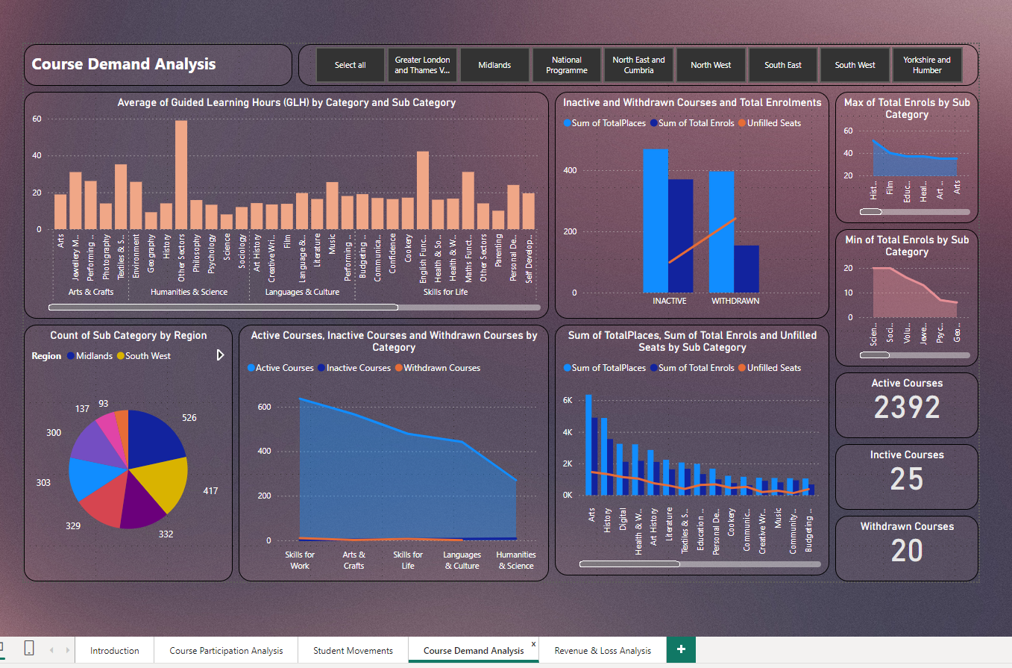
Visual 3: Course Demand
Column Chart: Average guided learning hours GLH by category and sub category.
Pie Chart: Count of sub-category by regions.
Area Chart: Sum of Active, inactive and withdrawn courses by category.
Line Clustered Column Chart: Inactive and withdrawn courses and total enrolments.
Line Clustered Column Chart: Sum of total places and unfilled seats by sub category.
Area Chart: Max and min total enrolments by sub category.
Card: Total active, inctive and withdrawn courses.

Slide 13
Problems & Solutions:
Generating more courses from History Background: People are more interested in history. So if we get more courses from the history category, then its more likely we can get more revenue from it. Also, we can maximize the enrolments (seats), but we will not increase the total places.
Removing places from less demand courses and adding them to high demand courses: Courses from sub-cat self-development (London, Midland), health & Social care (South-east), Philosophy (South-west), and language & Culture languages (South-west) Volunteering (Yorkshire and Humber), Management (south-west, Yorkshire and Humber), Photography (south-west), and Sociology (south-west) have more demand as the enrolment is higher than the available places, so if we can increase the seats for those courses, we can have fewer unfilled places.
Removing places from inactive and Withdrawn courses: There are seats available for inactive and withdrawn courses. If we can remove seats from those courses we can minimize the unfilled seat counts.

Slide 14
Identifying the key problems
Visual Page: 4
What is the potential revenue, total revenue and loss we have?
What is the total revenue and loss by category for each regions?

Slide 15
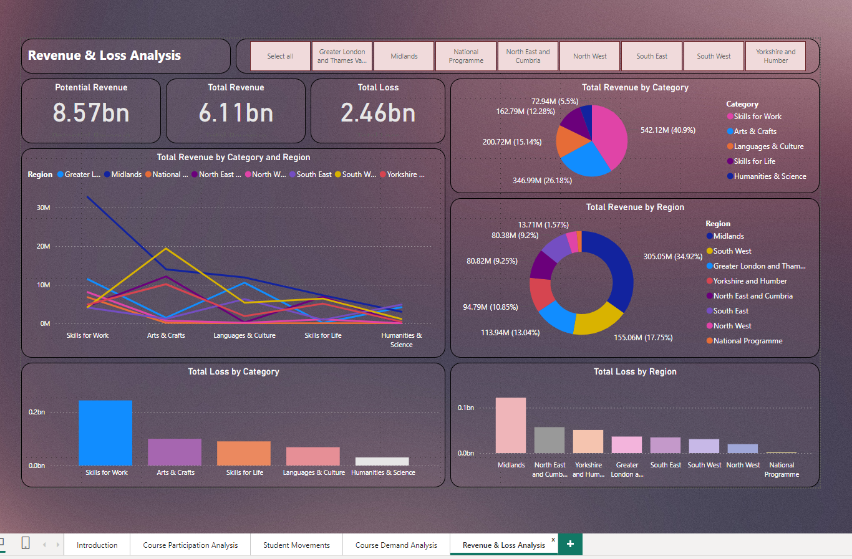
Visual 4: Revenue & Loss
Card: Potensial Revenue, Total Revenue and Total loss.
Line Chart: Total revenue by Category and Region.
Column Chart: Total loss by category.
Pie Chart: Total revenue by category.
Donut Chart: Total revenue by region.
Column Chart: Total loss by Region.

Slide 16
Problems & Solutions:
Remove unnecessary places for courses which are inactive, withdrawn, less demanding for each regions
Increase places for courses with high demand in particular regions.
Decreasing the course duration and minimizing the sessions for less demanding courses so that people will think of taking the courses and finish them early.
More advertisement and awareness about the courses, about the positive impact for their career.
Educating or giving proper guidance about the courses so that people will stop transferring from one course to another or less withdrawn count.
Providing awards after people finish the course will help people to finish there ongoing classes.
Creating more courses from the category like history, education, etc.

Slide 17
Thank You

